Slide 1
Forces and Magnets
LO: to observe what happens to different objects when a variety of forces are applied.
Today I want you to find things in your house that move or change shape. As you move them observe how and why they move. Slide 3 contains a table for you to complete.

Slide 2
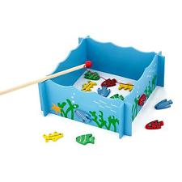
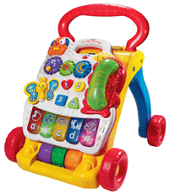
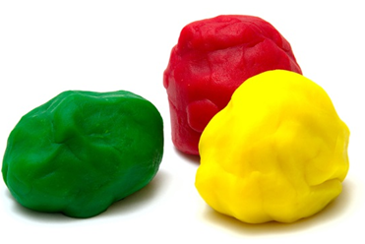
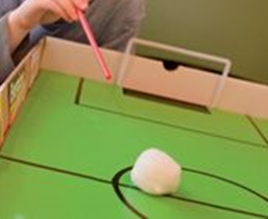
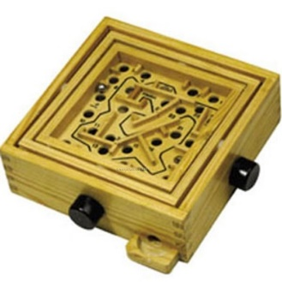
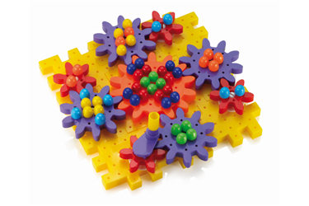
Try these activities or look for some of your own:
A magnet fishing game or you could use a magnet, paper clip of pieces of paper.
Go fishing! What happens?
Activity Centre: You can look for different activities in you house like they have on this toy. What do you observe?
Plastercine, play dough or pastry. What happens when you twist or squeeze it?
Blow Football: You could use a scrunched piece of paper and straw and have a race. What happens when you play this game?
Ball Maze: A game or a ball on some card with holes in it. What happens when you try to get the ball through the hole?
Cogs: This may be a tricky one see what you can find or look at this mechanism on-line.
Carefully observe this one.

Slide 3
Activity | Observation
Table Football | When I turn the handle with the players on they hit the ball and it moves across the table
Fishing Game
Plastercine
Ball Maze
Activity Centre
Blow Football
Cogs

