Slide 1
Life in the Trenches in The Great War
What was it like to be a soldier in French and Belgian trenches?

Slide 2
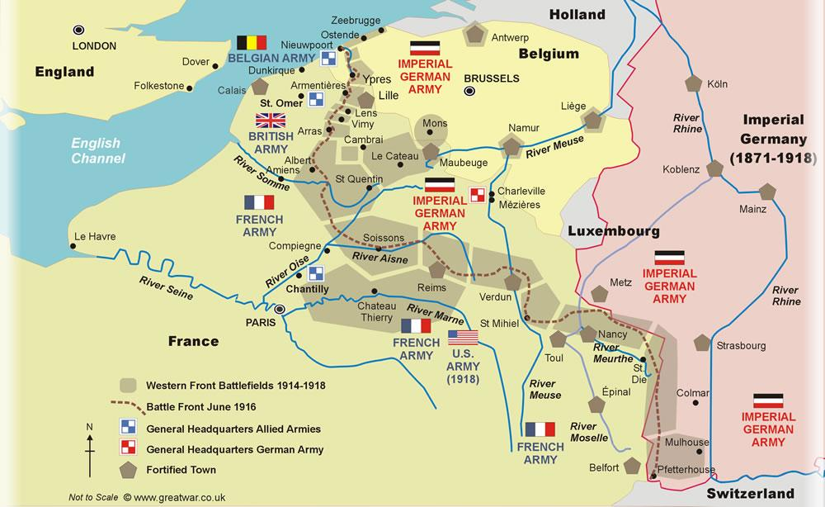
Where were the trenches?

Slide 3
How far did the trenches stretch?
The trenches extended from Nieuwpoort on the Belgian Coast to Pfetterhouse on the German/Swiss border.
In total, there were 25,000 miles of trenches; 12, 000 miles were occupied by the British Allies, the rest by the Germans and their allies.

Slide 4
Trench Maps
The trenches marked the limits of the territory gained by each side.
The German army was pushing towards the French and Belgian coast – if they could get to the coast, they could cross the channel into Britain.
The British and their allies needed to regain the territory that the Germans had gained.
The little bits of land in between the trenches was known as No-Man’s land – because neither side yet ‘owned’ it.

Slide 5
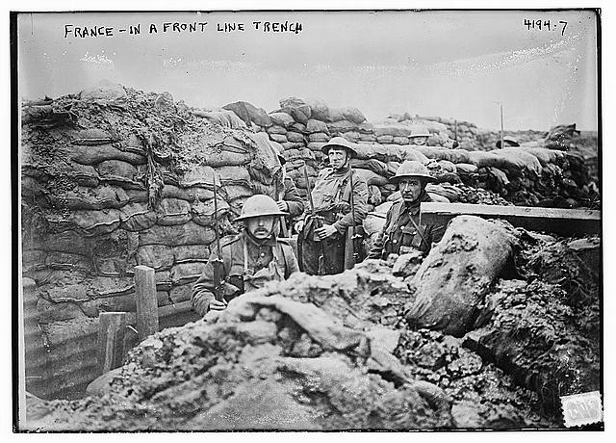
There were three types of trench
A Front Line trench – the last line before No-Man’s land from where enemies fired at each other.

Slide 6
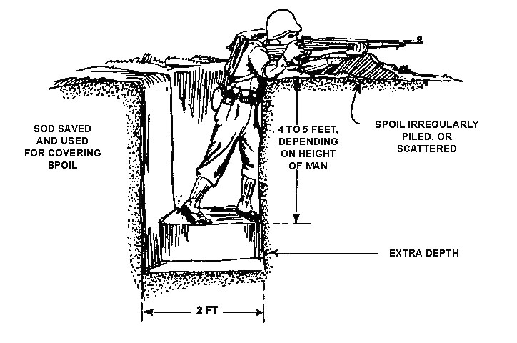
Firesteps
To enable soldiers to fire more safely at the enemy, they built ‘firesteps’ – a higher cutting in the side of the trench.

Slide 7
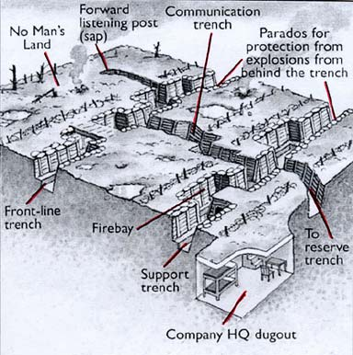
Communications Trenches and ‘Saps’
Communications
trenches enabled messages to be
passed to the front lines safely and would allow stretcher bearers to carry the wounded back to a safer position
Saps were short trenches which went into No-Man’s land. They enabled soldiers to get closer to the enemy, to throw grenades or to listen to plans or enemy approaches.

Slide 8
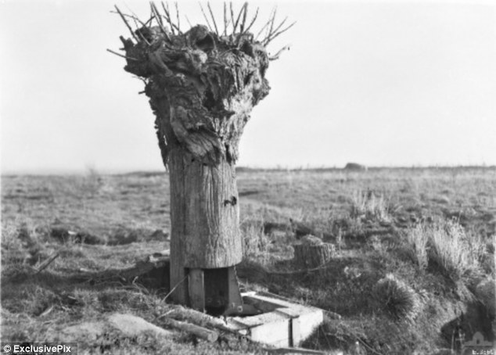
Stumps of trees were used as look out posts – blown up, they would be hollowed out and used as camouflage for spying on enemy trenches.

Slide 9
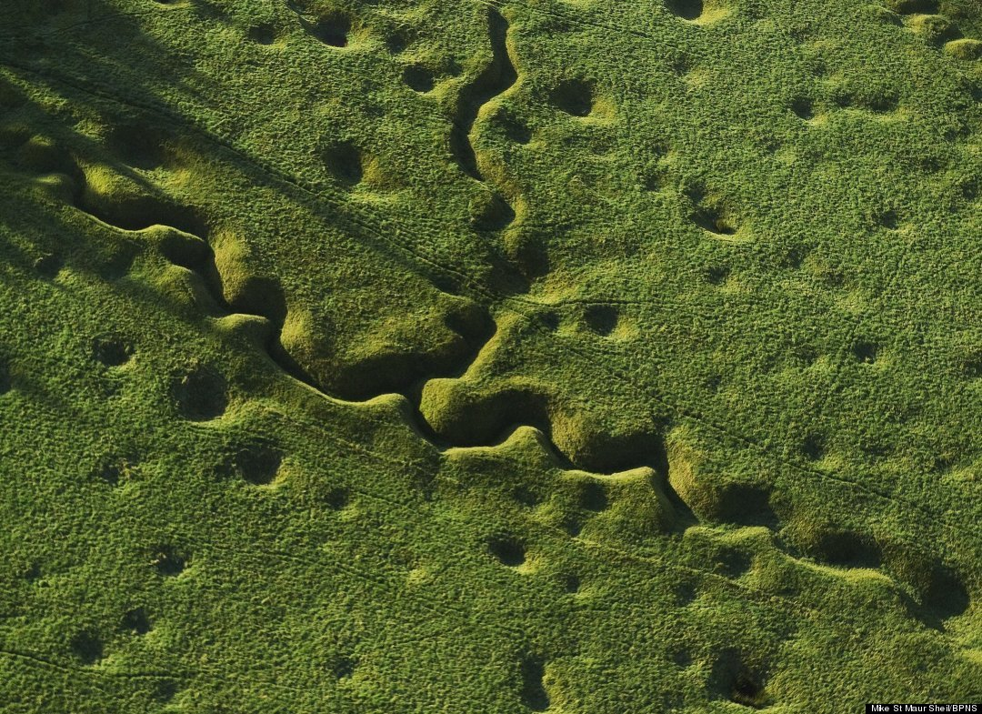
Trenches were not built in straight lines. This made it harder to capture them or to send fire down them.
This is a recent ariel photo of the trenches – the holes are left by shells.

Slide 10
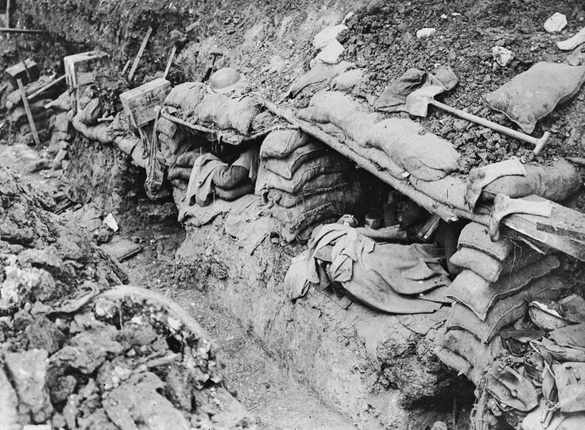
What was life like in the trenches?
This is how soldiers would sleep – in dug-out sections of the trench, supported by sand bags.

Slide 11
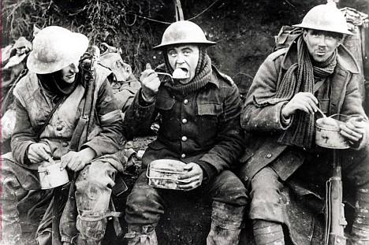
What was life like in the trenches?
Hot food in a trench was considered a luxury – the difficulty and danger of transporting it from a field kitchen to the front line was too great.

Slide 12
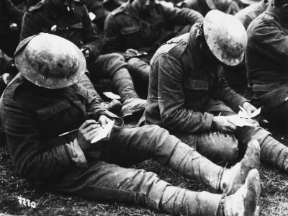
Letters from home
Writing to and receiving letters from home was the ONLY way of communicating for the soldiers. Twelve and a half million letters were sent to the the Western Front every week. In 1914 the Postal Section of the Royal Engineers had a staff of 250 men. By 1918 the Army Postal Service employed 4,000 soldiers. Letters only took two or three days to arrive from Britain. Even soldiers in the front
line trenches received daily deliveries of letters

Slide 13
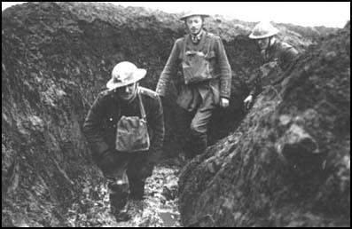
What happened when it rained?
One of the worst problems for the soldiers was the endless rain that fell on the battlefields.

Slide 14
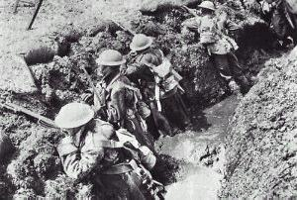
These men are standing in deep, wet, freezing mud. Their feet would be wet all the time.

Slide 15
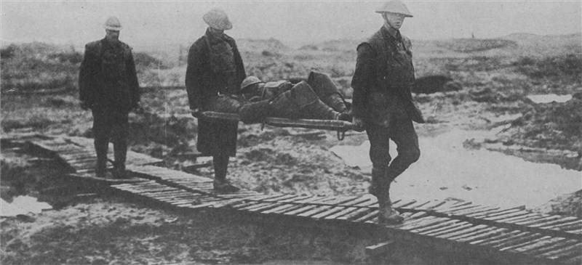
Rescuing the dead and injured from No-Man’s Land was made even harder by the mud.

Slide 16
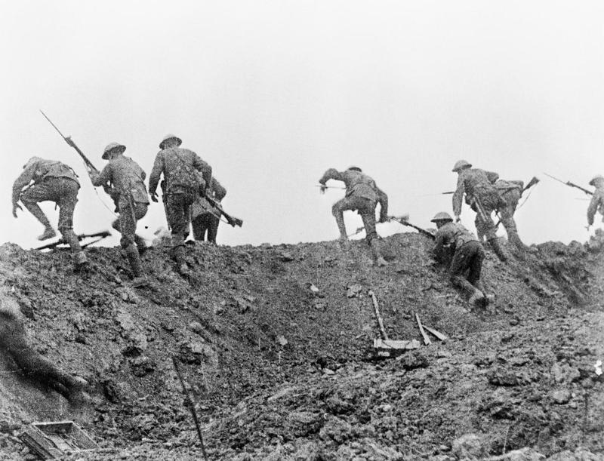
What was the fighting like?
This was known as
‘going over the top’.
Soldiers would be ordered to ‘advance’ towards the enemy trenches. The enemy, on seeing them approach would ‘mow them down’ with machine gun fire. Very few of the advancing soldiers would make it to the enemy trench.

Slide 17
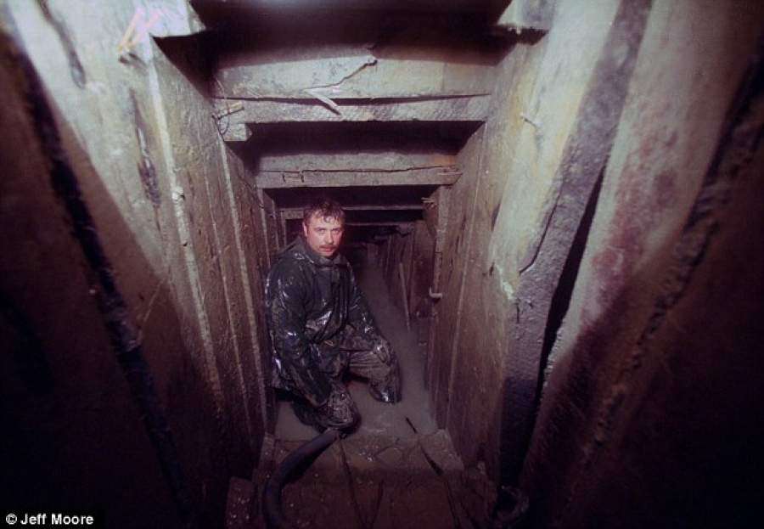
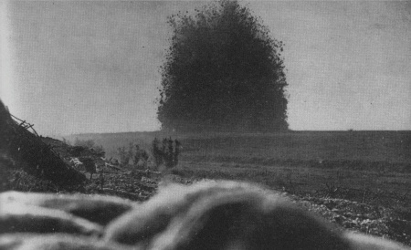
Miners were used to dig tunnels under the enemy lines. They laid explosives which would blow up without warning.
This explosion created the largest crater of the war, at
Boiselle. The noise of it was heard in England.

Slide 18
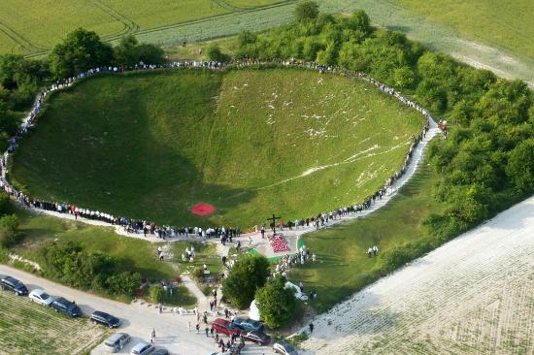
This is what it looks like today.

Slide 19
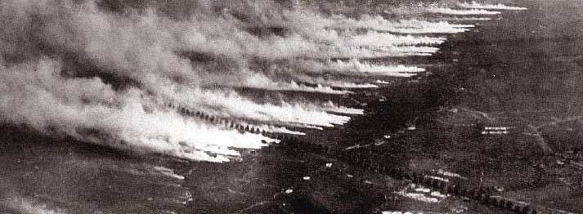
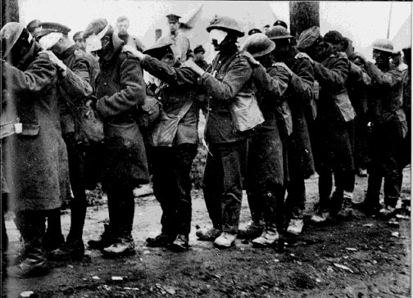
The new weapon used to devastating effect, was gas.
Soldier who weren’t killed by the gas were blinded by it.

Slide 20
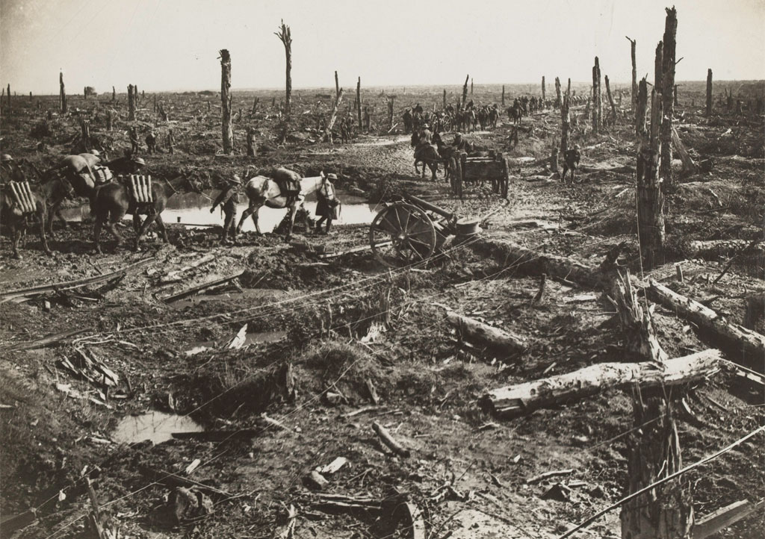
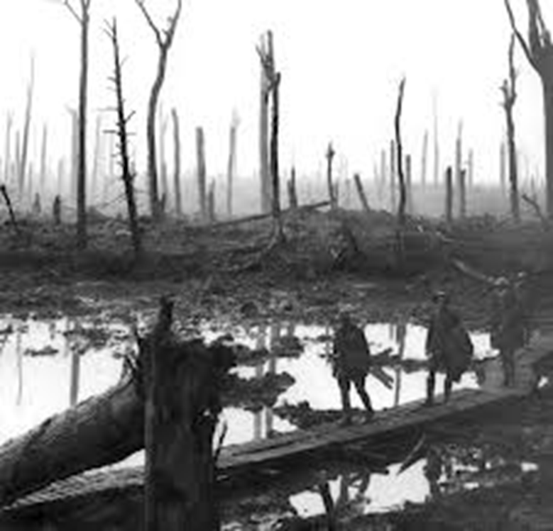
This is No-Man’s Land

Slide 21
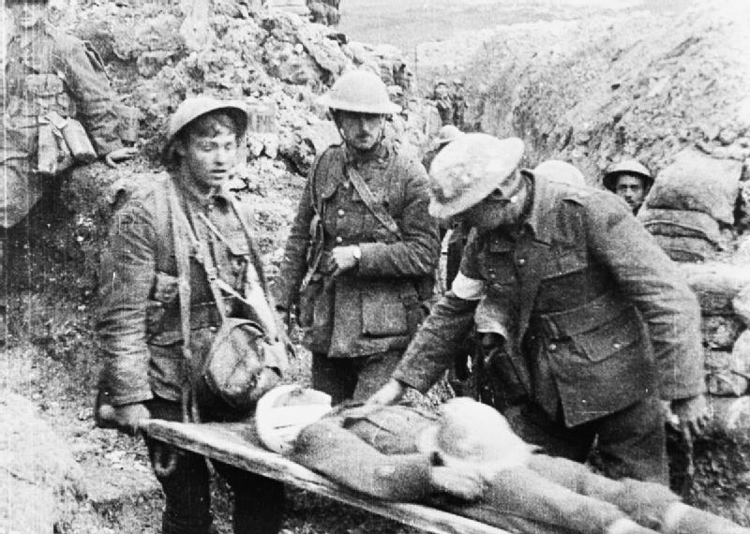
Conscientious objectors – those who would not fight – were often recruited as stretcher bearers.

Slide 22
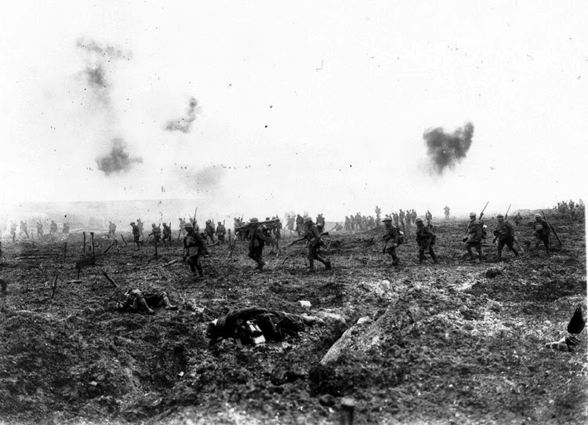
Soldier’s crossing No Man’s Land

Slide 23
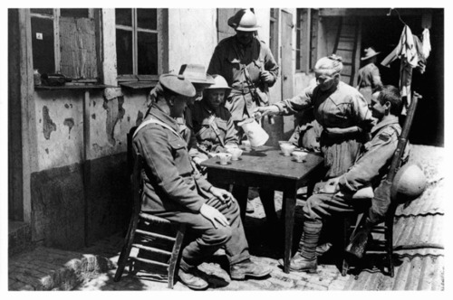
Occasionally, soldiers were able to visit local villages for a good meal (egg and chips), a beer and a bath.

