Slide 1
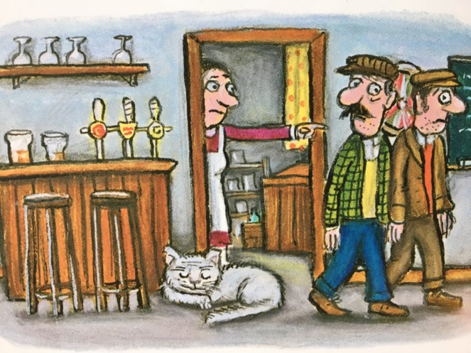
Relative Clauses

Slide 2
Relative Pronouns
Relative pronouns are used differently to other pronouns.
They introduce a relative clause.
Relative Pronouns
who, which, where, when, whose, that

Slide 3
Relative Pronouns
They can relate the clause to a noun.
Old Deuteronomy, who was sleepy, licked his tail.
Old Deuteronomy licked his tail which he coiled towards him.
Old Deuteronomy, whose tongue was very rough, licked his tail.
Old Deuteronomy licked the bite that the mouse had given him.
Relative Pronouns
who, which, where, when, whose, that

Slide 4
Relative Clauses
Relative clauses can also relate to a whole clause.
The cat caught the canary.
This is a clause.
It is not the cat which annoyed the owner. It is the catching of the canary. The relative clause relates to the whole clause.
The cat caught the canary,
which annoyed its owner.

Slide 5
Spotting Relative Clauses
Relative clauses are a type of subordinate clause.
main clause
subordinate clause
Gumbie slept on the bed
which was a very comfortable one.
The main clause is the main part of the sentence. It makes sense by itself.
The subordinate clause adds meaning to the main clause; it has less weight.
When the subordinate clause is a relative clause, it adds meaning to a noun in the main clause or to the whole main clause.
Revision

Slide 6
Spotting Relative Clauses
Old Deuteronomy stretched in the sunlight which was warm and comforting.
Gumbie sat on the hat which she had found on the hall table.
Identify the main clause and relative clause in each sentence.
What noun is the relative clause relating to?

Slide 7
Answers
main clause
subordinate clause
Old Deuteronomy stretched in the sunlight which was warm and comforting.
main clause
subordinate clause
Gumbie sat on the hat which she had found on the hall table.
Identify the main clause and relative clause in each sentence.
Which noun is the relative clause relating to?

Slide 8
Punctuating Relative Clauses
When the relative clause comes after the main clause,
we do not usually separate the clauses with a comma.
main clause
subordinate clause
Old Deuteronomy ignored the noise which was coming towards him.
A comma would create an unnecessary break in the sentence.

Slide 9
Punctuating Embedded Relative Clauses
Sometimes the relative clause is embedded in the main clause.
main clause
The mice ate the cheese.
The relative clause needs to be next to the noun: the mice.
Tell me more about The mice.

Slide 10
Punctuating Embedded Relative Clauses
Sometimes the relative clause is embedded in the main clause.
main clause
main clause
The mice, who did not know about the joke, ate the cheese.
The main clause splits to make space...
Tell me more about the mice.

Slide 11
Punctuating Embedded Relative Clauses
Sometimes the relative clause is embedded in the main clause.
main clause
subordinate clause
main clause
The mice, who were happy to have tasty food, ate the cheese.
Commas separate the clauses because the relative clause breaks up the main clause.
The main clause splits to make space...
for the relative clause.
Tell me more about the mice.

Slide 12
Embedding Relative Clauses
main clause
Read these main clauses.
Embed a relative clause to say more about the noun.
Remember to use commas.
Gumbie slept on the papers.
The dog skirted around Old Deuteronomy.
The bed looked tempting to the cat.
The mouse ate all the cheese and bacon.

Slide 13
What meaning did you add to the clauses?
,
,
main clause
subordinate clause
main clause
Gumbie, who was tired after a busy night, slept on the papers.
The dog, who did not want to disturb his sleep, skirted around Old Deuteronomy.
The bed, which had been made that very morning, looked tempting to the cat.
The mouse, whose stomach had been rumbling, ate all the cheese and bacon.
Check your punctuation.

Slide 14
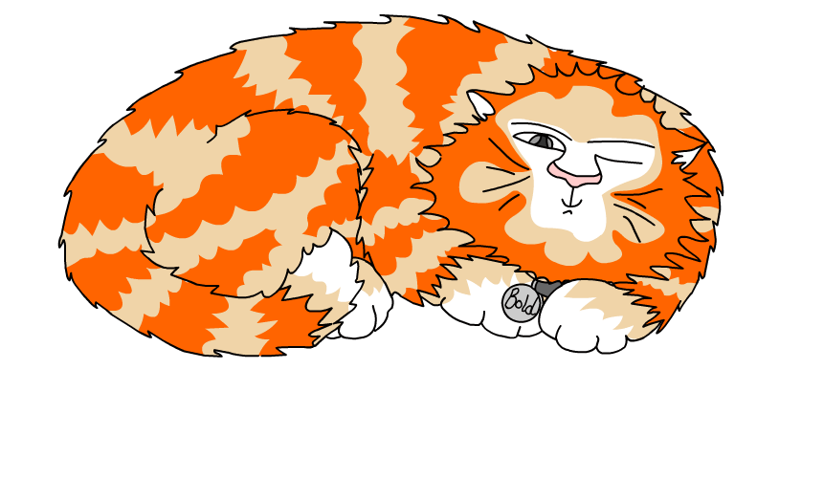
Explore more Hamilton Trust Learning Materials at https://wrht.org.uk/hamilton/ .

