Slide 1
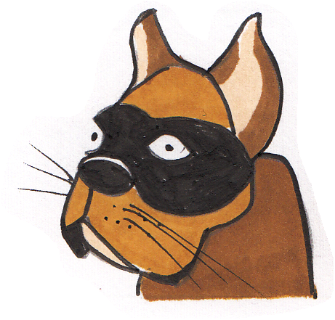
Determiners
?
You are a hero.
You are the hero.
You are my hero.
You are your hero.

Slide 2
A determiner tells us a bit more about a noun.
Determiners go next to their noun or at the beginning of a noun phrase.
They don’t carry the meaning but they do influence it.
a brown dog
the brown dog
my brown dog
her brown dog
that brown dog
the brown dog over there
the brown dog that belongs to her
the brown dog that belongs to me
the brown dog we saw before
any brown dog

Slide 3
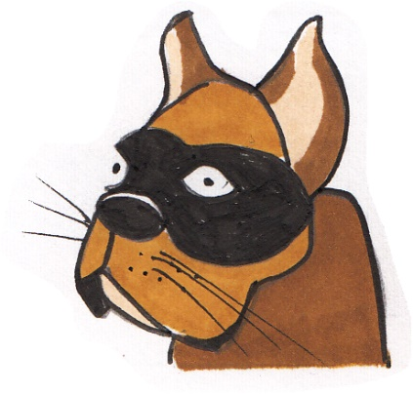
There are different types of determiner.
They give different types of information about their noun.
Articles
a
an
the
Possessives
my
your
his
her
its
our
their
Quantifier/
Numbers
some
any
no
every
one
two
Demonstratives
this
that
these
those
We don’t need to know the categories, but it helps to know what determiners do.
a and an suggest any noun.
the suggests it is specific.
shows near or far nouns
shows ownership
shows amounts/
numbers
a brown dog
Notes:
Possessive pronouns and determiners.
Possessive pronouns are slightly tricky
If they stand on their own to preplace a noun, they are possessive pronouns. E.g. The book was his. (his replaces ‘Tom’s.)
If they precede a noun, e.g. his book, then, strictly, these are possessive determiners as they behave like adjectives.
There are also relative pronouns which appear in Y5 NC so are not tackled here.

Slide 4
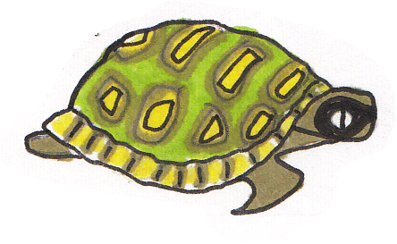
Can you spot the determiners?
Hint: look for words which specify the noun or noun phrase.
I have never jumped out of a plane.
I have never climbed the highest mountain.
I have never swum across any river.
I have never carried my neighbour out of a burning building.
I have never done these heroic things.
I sometimes struggle to come out of my shell.
a super tortoise
ANSWERS
Notes:
Occasionally ‘it’ is a ‘dummy pronoun’ when it refers not to anything specific but to an undetermined actor or subject.
Because of this function, ‘it’ is sometimes called a place holder. E.g. It is raining. It all depends...

Slide 5
Thinking about the way determiners change the meaning.
This is a cake.
This is my cake.
This is that cake.
It is no particular cake. It’s not the cake.
The cake is all mine!
The cake is the one I told you about.
Determiners tell us a bit more about the noun.
They can change the meaning in subtle ways.
Notes:
Occasionally ‘it’ is a ‘dummy pronoun’ when it refers not to anything specific but to an undetermined actor or subject.
Because of this function, ‘it’ is sometimes called a place holder. E.g. It is raining. It all depends...

Slide 6
Thinking about the way determiners change the meaning.
I like any pudding.
I like your pudding.
I like this pudding.
I like the pudding you have.
ANSWERS
A small determiner can make a big impact on the meaning.
I like the pudding I see here.
I like all puddings.
Can you match the determiner to the meaning?
Notes:
Occasionally ‘it’ is a ‘dummy pronoun’ when it refers not to anything specific but to an undetermined actor or subject.
Because of this function, ‘it’ is sometimes called a place holder. E.g. It is raining. It all depends...

Slide 7
Can you chose the best determiner?
The bike belongs to mike.
She was given a piece to do for Maths.
It was one of many in the fruit bowl.
There were many on the ground and it was just the nearest one.
Could you hear the difference the determiner made?
Mike rides ____ bike to school. (a/his)
his
the
Shopna did ____ homework. (some/the)
an
Ava ate ____ apple. (an/that)
Jay picked up ___ leaf on the ground. (a/that)
a
Read each sentence as it appears and choose the best determiner.
Try saying it to see the impact of your choice.
Notes:
Occasionally ‘it’ is a ‘dummy pronoun’ when it refers not to anything specific but to an undetermined actor or subject.
Because of this function, ‘it’ is sometimes called a place holder. E.g. It is raining. It all depends...

Slide 8
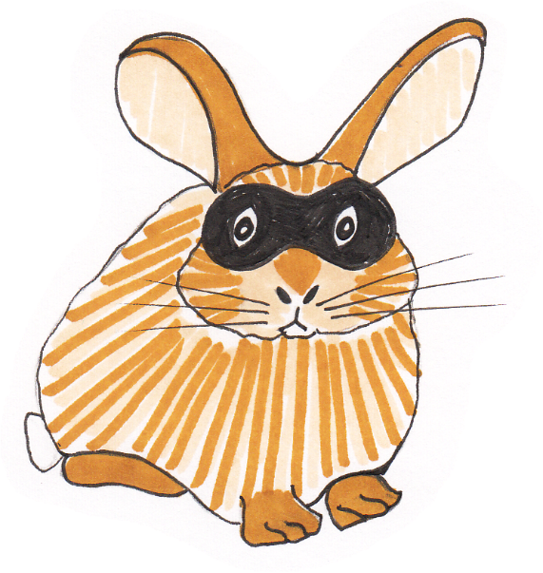
A determiner tells us a bit more about a noun.
We still need the noun. The determiner works with it.
This rabbit is undercover.
His mask is black.
The mask is his.
Look carefully at the determiners. The determiners go in front of the nouns.
This is not a determiner.
It has replaced the noun (rabbit’s).
Determiners work with nouns. They do not replace them.

Slide 9
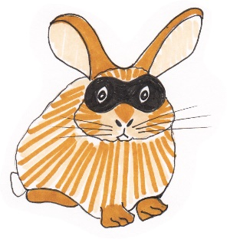
Identifying Determiners
Determiner
Not a Determiner
Pick a card.
The balloon popped.
I forgot my hat .
I can’t find mine.
That shoe is his.
Have you any money?
Fluffy was cross that we didn’t bring her.
Fluffy chewed her mask.
Can you sort the underlined words?
Hint: look for the noun that the determiner is specifying.

Slide 10
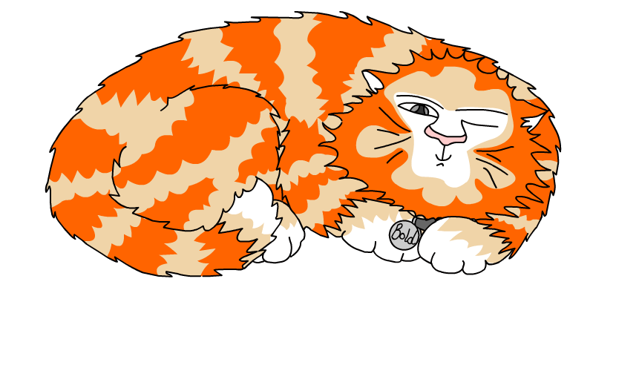
Explore more Hamilton Trust Learning Materials at https://wrht.org.uk/hamilton/ .

