Slide 1
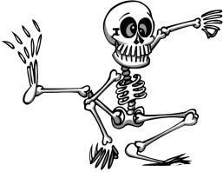
The
instruction
book
revised
advanced
Sue Palmer

Slide 2
Instruction text
tells how to do or
make something.
It is usually sequential.

Slide 3
These texts are
often instructions…
non-fiction book
(e.g. sports skills, art, design)
recipe
DIY book
sewing or knitting pattern
instruction
science experiment
technical manual
(e.g. for car or computer)
instructions
on packaging
(e.g. food, clothing,
superglue)
posters, notices signs

Slide 4
Instruction text
needs
Purpose
a title telling what’s to be achieved
to break the instructions into simple steps
if relevant, list(s) of ingredients/equipment needed
layout which clearly shows the sequence of steps
to explain them step by step, as clearly and simply as possible
perhaps labelled pictures or diagrams
especially a picture of the finished product, so the reader knows what to aim for
to ensure the reader’s success in carrying out the instructions.
perhaps other organisational devices (e.g. boxes for additional information, bullet points, warning symbols) to aid clarity.
The genre of text can also affect the purpose.

Slide 5
Instruction writing
Audience
Use what you know about your audience to decide
think about the audience for the instructions
how much background detail is needed
how much do you know about them (age, interests, prior knowledge)?
appropriate level of formality.
Where should the text sit along these continua?
informal
formal
personal
impersonal
The position on each continuum may be different. Impersonal texts are sometimes written informally, and personal texts may be formal.

Slide 6
How to plan instruction writing
4.
Look back at the flow chart. Add any further necessary details.
3.
Jot down notes for each step on a flow chart.
2.
If possible, actually do or make whatever it is yourself, refining the
steps.
1.
Plan a flow chart of the process breaking it into obvious steps.
Draw any diagram(s) you need.
As you go, list ingredients/equipment.

Slide 7
Organising instruction text
Title:
what’s to be achieved
Maybe...
labelled
diagram(s)
What you need
-------------------
-------------------
-------------------
-------------------
What to do, one step at a time.
When you have made your flow-chart skeleton,
each section of the flow-chart will be one paragraph or section of writing.

Slide 8
Instruction language features
clear, concise vocabulary and sentence structures
Mix the flour...
present tense imperative verbs
Cut along the line...
clear statements of quantities, measurements and other relevant details
Press the space bar...
Feed and exercise your dog...
descriptive language used for clarity rather than vividness or effect
Always use the correct equipment.
numbers and/or time connectives to show stages in a process.

Slide 9
Third person instructions
When more than one person involved, e.g. a game
Player A takes a card...
Team 1 tries to score points...
* third person
* present tense
Team 2 tries to stop them...
* provide names or labels.
The batting side...
The fielding side...

Slide 10
Alternative ‘skeleton’ note-taking frameworks
* comic strip
* time line
* list

Slide 11
Example of
‘skeletons’
in use
Taken from ‘How to teach Writing Across the Curriculum’ by Sue Palmer, with many thanks to David Fulton Publishers

Slide 12
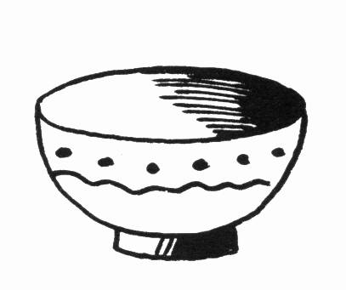
How to make a papier mâché bowl
You will need:
half a cup of flour
half a cup of water
a tablespoon of salt
a container for mixing paste
newspaper, torn into thin strips
a balloon, blown up and knotted
a strip of card (about 30cm by 4cm)
sticky tape and scissors
paint and brushes
varnish and brush
First make the paste. Put the flour and salt into a container and gradually mix in the water until it is thick and creamy.
Dip the strips of newspaper into the paste and smooth them down on to the unknotted end of the balloon. Cover enough of the balloon to make a bowl shape. Use three or four layers of paper strips. Leave to dry.
Make a base for the bowl by taping the card into a circle shape, and taping it on to the balloon. Cover with a few more paper strips to hold it in place.
Pop the balloon and remove its plastic skin. Ask a grown-up to help you trim the bowl, and smooth more paste strips over the edge to finish it off. Leave to dry.
Paint the bowl in bright colours. When dry , brush on a final coat of varnish.
Papier mâché is the French for ‘chewed paper’! It is a mixture of paper and paste that hardens when dry.
Skeleton

Slide 13
card circle
1.
Make paste
2.
Paper the balloon
3.
Make base
flour and salt and water
3-4 layers of paper strips
tape and paper strips
4.
Pop balloon Trim bowl
5.
Paint and varnish
Finished bowl
Adult help
Text

Slide 14
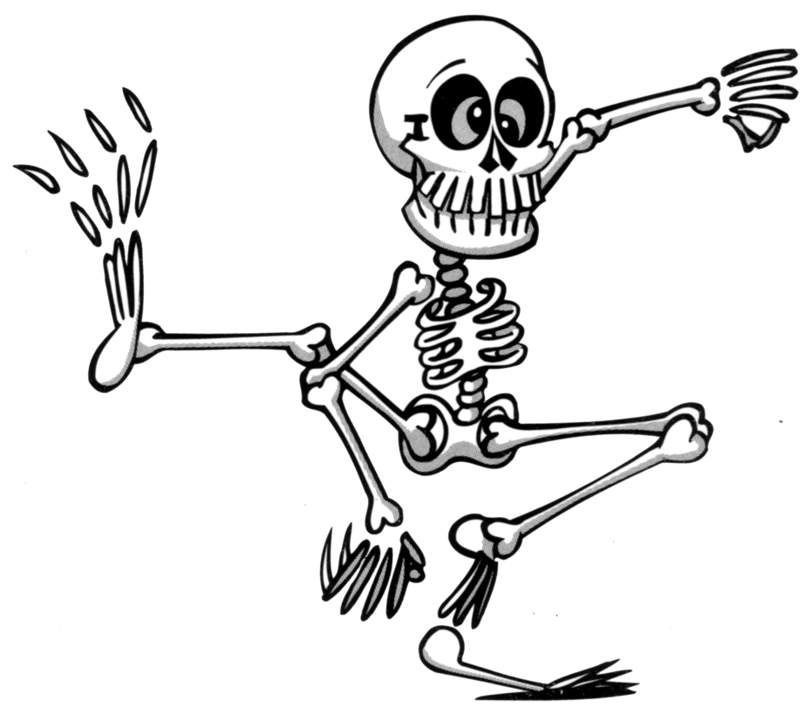
The End

