Slide 1
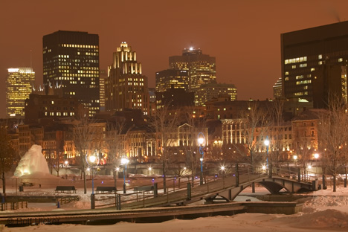
Brainstorm“wow words” or phrases to describe this picture.
How does it make you feel?
What can you see, hear and smell?

